Slide 1
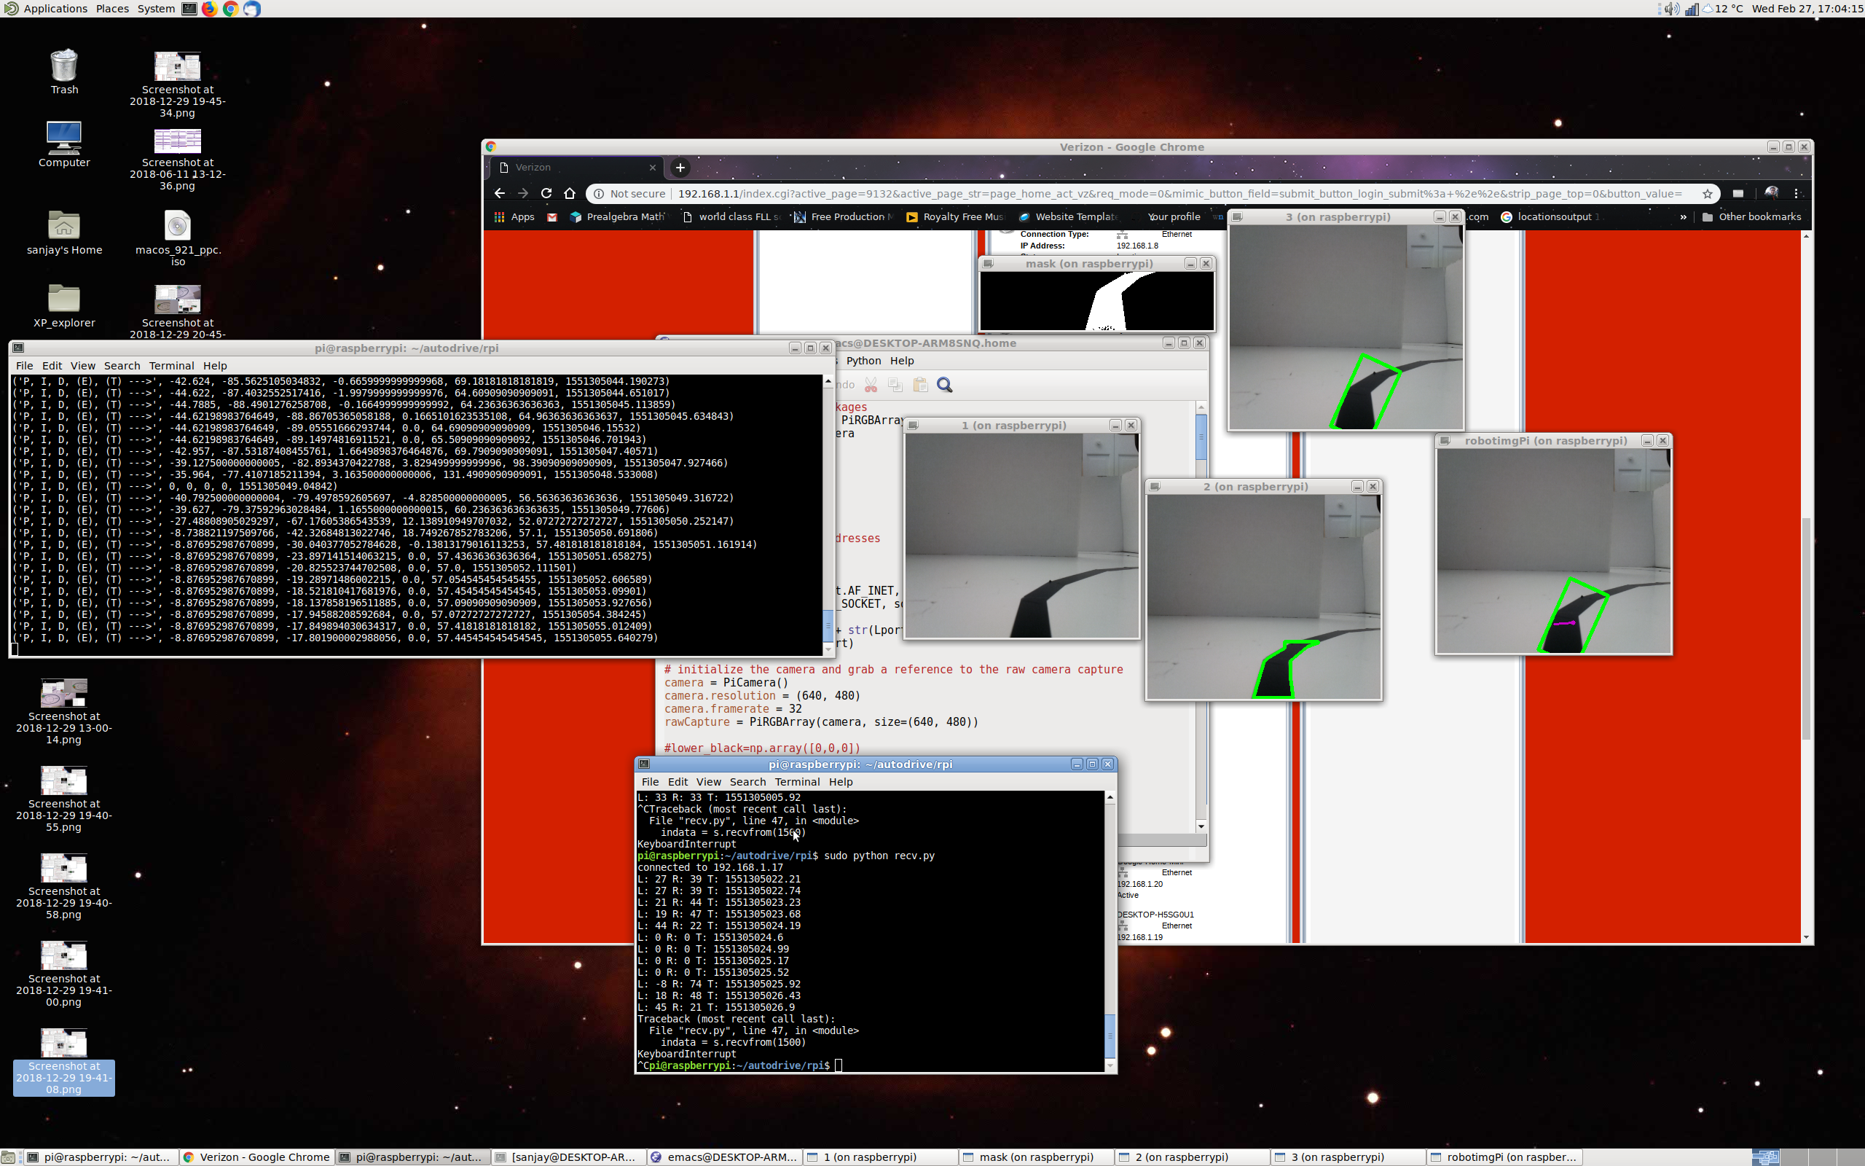
Capture image (a)
(a)
Identify black pixels(b)
Identify largest black region (c)
(b)
Draw rectangle around region (d)
(c)
Compute distance between robot
and frame center (error estimate) (e)
Compute change and integral of error estimate
(d)
Compute correction from angle & distance errors
(e)
Transmit correction to robot

Slide 2
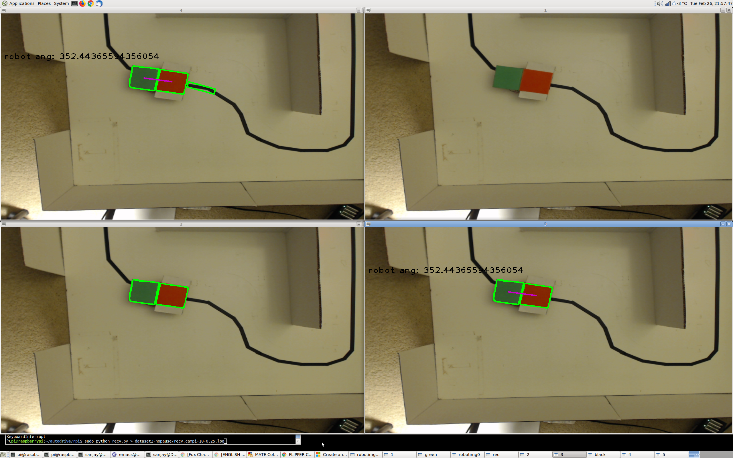
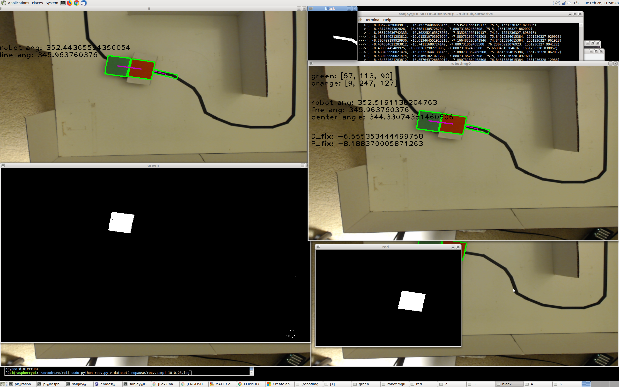
Capture image (a)
(a)
Identify green/orange pixels (b)
Identify largest green/orange regions (c)
(b)
Draw line between green/orange regions (d)
green
orange
Compute angle of drawn line
(c)
Crop image in front of robot
Identify largest black region
Draw rectangle around region (e)
(d)
Compute angle & center of rectangle (f)
Compute angle differences between robot & rectangle
Compute distance between robot & rectangle centers
(e)
(f)
Compute correction from angle & distance errors
Transmit correction to robot (g)
(g)

Slide 3
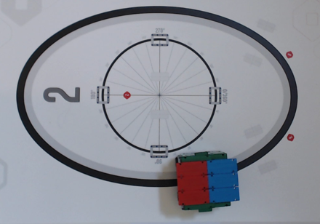
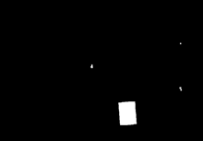
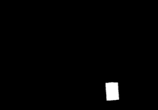
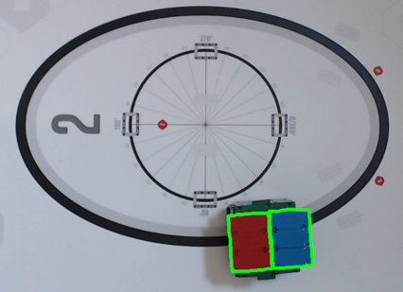
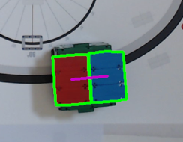
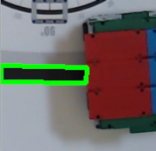
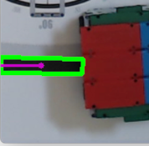
Capture image (a)
Identify blue/red pixels (b)
(a)
Identify largest blue/red regions (c)
Draw line between blue/red regions (d)
(b)
Compute angle of drawn line
red
blue
Crop image in front of robot
(c)
Identify largest black region
Draw rectangle around region (e)
(d)
Compute angle & center of rectangle (f)
Compute angle differences between robot & rectangle
(e)
(f)
Compute distance between robot & rectangle centers
Compute correction from angle & distance errors
Transmit correction to robot

